Slide 1
Unit 3 Greedy algorithms

Slide 2
Greedy algorithm
An algorithm is greedy if it builds up a solution in small steps, choosing a decision at each step myopically to optimize some underlying criterion.
One can often design many different greedy algorithms for the same problem, each one locally, incrementally optimizing some different measure on its way to a solution.

Slide 3


Contents
Interval Scheduling
Scheduling to minimize lateness.
Optimal Caching

Slide 4
Interval scheduling problem
Consider this classroom be scheduled for the following classes.
DAA (9-10)
CO (10-11)
DC(9.30-10.30)
MAT (2-3)
Python(2.30-3.30)
Which of the schedules are not compatible?

Slide 5
Interval scheduling problem
Which of the schedules are compatible?
{1,2}
Which of the schedules are not compatible?
What is the optimal solution??
1
2
3
4
5

Slide 6
Interval Scheduling- Problem
Formally Requests 1,2,…,n.
Request i has start time s(i) and finish time
Requests i and j are compatible iff either
request i is for a time entirely before request j
f(i) <= s(j)
or, request j is for a time entirely before request i
f(j) <= s(i)
Goal: Find maximum size subset A of compatible requests

Slide 7
Interval scheduling-Problem
The available inputs for the problem are:
Number of requests
Start time =[…………..]
Finish time=[………….]
So what can be the approaches here?
Sorting?
If sorting means according to what?
Is it finish time or start time?

Slide 8
Interval Scheduling- Approaches
[Earliest start time] Consider jobs in ascending order of s_{j}.
How many intervals can be selected according to this approach?
What is the optimal number ??

Slide 9
Interval Scheduling- Approaches
[Shortest interval] Consider jobs in ascending order of f_{j} - s_{j}.
How many intervals can be selected according to this approach?
What is the optimal number ??

Slide 10
Interval Scheduling- Approaches
[Fewest conflicts] For each job j, count the number of conflicting jobs c_{j}. Schedule in ascending order of c_{j}.
Conflicts for red colored intervals-1
Conflicts for yellow colored intervals-3 and 3
Conflicts for green colored intervals-3 and 3…..

Slide 11
Interval Scheduling- Approaches
[Earliest start time] Consider jobs in ascending order of s_{j}.
[Shortest interval] Consider jobs in ascending order of f_{j} - s_{j}.
[Fewest conflicts] For each job j, count the number of conflicting jobs c_{j}. Schedule in ascending order of c_{j}.
counterexample for earliest start time
counterexample for shortest interval
counterexample for fewest conflicts

Slide 12
Interval Scheduling- Approaches
So what is the approach remaining???

Slide 13
Interval Scheduling- Approaches
[Earliest finishtime] Consider jobs in ascending order of f_{j}.
Solution =4 intervals
Solution =2 intervals
Solution =4 intervals

Slide 14
Interval Scheduling- Approaches
So what is the greedy approach?
Why it is greedy??

Slide 15




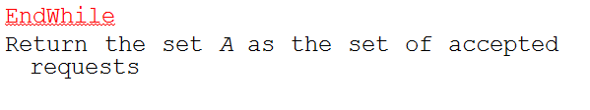
Interval Scheduling- Algorithm
1
2
3

Slide 16



Interval Scheduling-Example

Slide 17

Interval Scheduling-Example

Slide 18
Problem – Interval Scheduling
Find the intervals that can be scheduled for the following set of requests.
g
b
e
h
a
c
d
f

Slide 19
Implementation and running time Analysis
f_sorted=sort the n requests in
order of finish time O(n logn)
schedule = {}
last_finish = 0
for i = 1 to n:
if s(i)>= last_finish:
Add i to schedule
last_finish = f_sorted(i)
endif
endfor
return schedule

Slide 20
Summary
Interval scheduling problem
Approach for the scheduling problem
Small examples

Slide 21
Analysis-Proof of correctness
The greedy algorithm returns an optimal set A.
A is a compatible set of requests.
When do you say it as compatible?
f (i) ≤ f (j)------------------------→ (1)
Let A={i₁, . . . , i_{k} } Note that |A| = k. Similarly,
O ={j₁, . . . , j_{m} } Our goal is to prove that
k = m.

Slide 22
Analysis-Proof of correctness
A is a compatible set of requests
Let i₁, . . . , i_{k} be the set of requests in A in the order they were added to A. Note that |A| = k. Similarly,
Let the set of requests in optimal set O be denoted by j₁, . . . , j_{m}. Our goal is to prove that k = m.
we now prove that for each r ≥ 1, the rth accepted request in the algorithm’s schedule finishes no later than the rth request in the optimal schedule.
i.e. For all indices r ≤ k we have f (i_{r}) ≤ f (j_{r})-→ (2)

Slide 23
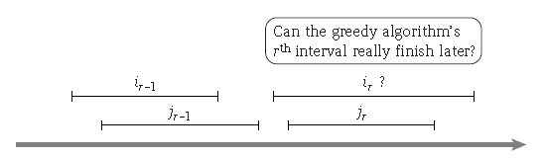
Analysis-Proof of correctness
A is a compatible set of requests
i.e. For all indices r ≤ k we have f (i_{r}) ≤ f (j_{r}).
For r = 1 the statement is clearly true: the algorithm starts by selecting the request i₁ with minimum finish time.
let r > 1, assume the following set of requests for the greedy and the optimal schedule.

Slide 24
Analysis-Proof of correctness
A is a compatible set of requests
i.e. For all indices r ≤ k we have f (i_{r}) ≤ f (j_{r}).
f (j_{r−1}) ≤ s(j_{r}).
f (i_{r−1}) ≤ f (j_{r−1}),
we get f (i_{r−1}) ≤ s(j_{r}).

Slide 25
Analysis-Proof of correctness
A is a compatible set of requests
i.e. For all indices r ≤ k we have f (i_{r}) ≤ f (j_{r}).
f (j_{r−1}) ≤ s(j_{r}).
f (i_{r−1}) ≤ f (j_{r−1}),
we get f (i_{r−1}) ≤ s(j_{r}).
The greedy algorithm selects the available interval with smallest finish time; since interval j_{r} is one of these available intervals, we have f (i_{r}) ≤ f (j_{r}).

Slide 26
Analysis-Proof of correctness
The greedy algorithm returns an optimal set A.
A is set of compatible requests---→ 1
For all indices r ≤ k we have f (i_{r}) ≤ f (j_{r})--→ 2
If A is not optimal, then an optimal set O must have more requests, that is, we must have m > k.
With r = k, we get that f (i_{k}) ≤ f (j_{k}). By 2
Since m > k, there is a request j_{k+1} in O

Slide 27
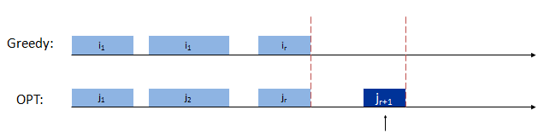
Analysis-Proof of correctness
The greedy algorithm returns an optimal set A.
If A is not optimal, then an optimal set O must have more requests, that is, we must have m > k.
With r = k, we get that f (i_{k}) ≤ f (j_{k}). By 2
Since m > k, there is a request j_{k+1} in O
But the greedy algorithm stops with request i_{k}, and it is only supposed to stop when R is empty—a contradiction. Hence, the set A returned is optimal

Slide 28
Interval Partitioning Problem or Scheduling all intervals
In the Interval Scheduling Problem, there is a single resource and many requests in the form of time intervals, so we must choose which requests to accept and which to reject.
A related problem arises if we have many identical resources available and we wish to schedule all the requests using as few resources as possible.

Slide 29
Interval Partitioning Problem or Scheduling all intervals
For example, suppose that each request corresponds to a lecture that needs to be scheduled in a classroom for a particular interval of time.
We wish to satisfy all these requests, using as few classrooms as possible.
The classrooms at our disposal are thus the multiple resources, and the basic constraint is that any two lectures that overlap in time must be scheduled in different classrooms.

Slide 30
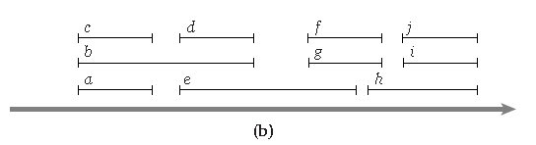
Example
First find the requests that are compatible with each other based on the earliest finish time.
***{c,d,f,i}, {a,e,j},{b,h} or {c,d,f,j}, {a,e,i},{b,h} there must be atleast 3 resources.
{c,d,f,j},{b,g,i},{a,e,h}

Slide 31
Summary- Interval Scheduling
Problem consisted of a set of requests in R and goal is to find the maximum subset from R.
What approach is suitable?
Earliest finish.
The time complexity of the algorithm discussed is nlogn.
The optimality of the set of requests A is proved.

Slide 32
Optimal caching- Problem
Caching.
Cache with capacity to store k items.
Sequence of m item requests d₁, d₂, …, d_{m}.
Cache hit: item already in cache when requested.
Cache miss: item not already in cache when requested: must bring requested item into cache, and evict some existing item, if full.
Goal. Eviction schedule that minimizes number of cache misses.

Slide 33
Optimal caching- Algorithm -Farthest-in-Future
When di needs to be brought into the cache,
evict the item that is needed the farthest into the future
Ex: k = 2, initial cache = ab, requests: a, b, c, b, c, a, a, b.
Optimal eviction schedule: 2 cache misses.
red = cache miss
a
a
b
b
a
b
c
c
b
b
c
b
c
c
b
a
a
b
a
a
b
b
a
b
requests
cache

Slide 34
Optimal caching- Algorithm -Farthest-in-Future
When di needs to be brought into the cache,
evict the item that is needed the farthest into the future
Ex: a, b, c, d, a, d, e, a, d, b, c
k=3
initial cache = a,b,c

Slide 35
Optimal caching- Algorithm -Farthest-in-Future
When di needs to be brought into the cache,
evict the item that is needed the farthest into the future
Ex: a, b, c, d, a, d, e, a, d, b, c
k=3
a
a
b
c
b
a
b
c
c
a
b
c
d
a
b
d
a
a
b
d
Cache
miss
d
a
b
d
e
a
e
d
a
a
e
d
d
a
e
d
b
b
e
d
c
b
c
d
requests
cache

Slide 36

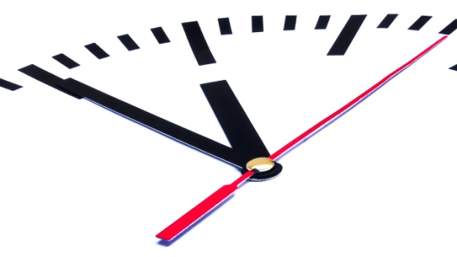
Scheduling to minimize lateness

Slide 37
Scheduling to minimize lateness
Instead of a start time and finish time, the request i has a deadline d_{i}, and it requires a contiguous time interval of length t_{i},
Can be scheduled at any time before the deadline.
1 | d=2 | t=1
2 | d=4 | t=4
How can you schedule now
for these type of requests??

Slide 38
Scheduling to minimize lateness
Each interval is denoted by [s(i), f (i)], with
f (i) = s(i) + t_{i}.
where, s(i)= start time of the interval i
f(i)=finish time of the interval i
t_{i}= time length of the interval I
We say that a request i is late if it misses the deadline, that is, if f (i) > d_{i}.
The lateness of such a request i is defined to be l_{i} = f (i) − d_{i}.

Slide 39
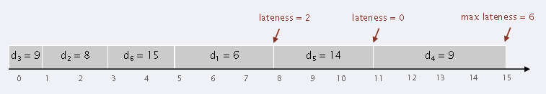
Scheduling to minimize lateness- Example
 | 1 | 2 | 3 | 4 | 5 | 6
t(j) | 3 | 2 | 1 | 4 | 3 | 2
d(j) | 6 | 8 | 9 | 9 | 14 | 15

Slide 40

Scheduling to minimize lateness- Goal
The goal in our new optimization problem will be to schedule all requests, using
non-overlapping intervals, so as to minimize the maximum lateness, L = max_{i} l_{i}.

Slide 41

Scheduling to minimize lateness
Natural approaches.
increasing length t_{i}
Request | 1 | 2
t_{j} | 1 | 3
d_{j} | 2 | 5

Slide 42
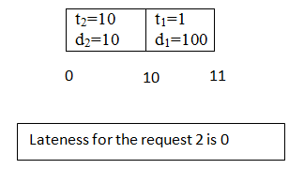
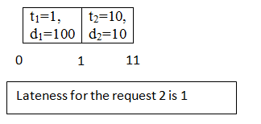
Scheduling to minimize lateness
Natural approaches.
increasing length t_{i}
Counter example
Request | 1 | 2
t_{j} | 1 | 10
d_{j} | 100 | 10
If request 2 is
scheduled first

Slide 43

Scheduling to minimize lateness
Natural approaches.
slack time d_{i} − t_{i} is very small
Request | 1 | 2
t_{j} | 1 | 3
d_{j} | 2 | 5
Sl_{i} (Slack) | 1 | 2

Slide 44
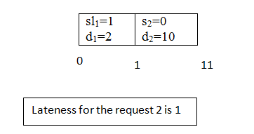
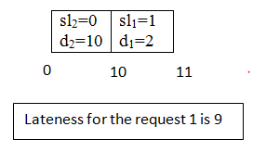
Scheduling to minimize lateness
Natural approaches.
slack time d_{i} − t_{i} is very small
Counter example
Request | 1 | 2
t_{j} | 1 | 10
d_{j} | 2 | 10
sl_{i} | 1 | 0
If request 1
Was scheduled
first

Slide 45


Scheduling to minimize lateness- Goal revisited
The goal in our new optimization problem will be to schedule all requests, using
non-overlapping intervals, so as to minimize the maximum lateness, L = max_{i} l_{i}.
Earliest

Slide 46
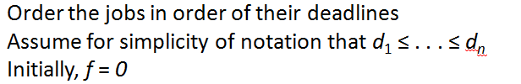


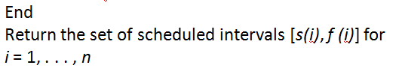
Scheduling to minimize lateness- Algorithm
1
2
3

Slide 47
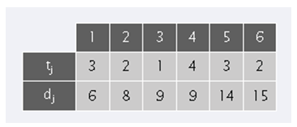
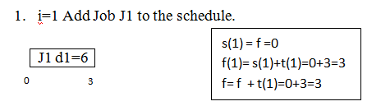
Scheduling to minimize lateness- Example

Slide 48
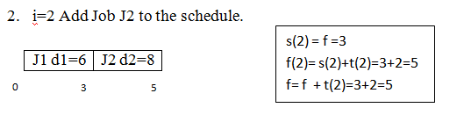
Scheduling to minimize lateness- Example

Slide 49
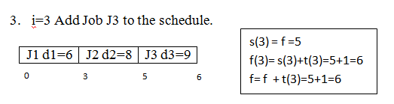
Scheduling to minimize lateness- Example

Slide 50
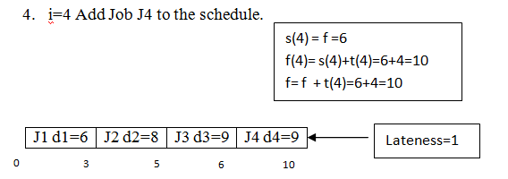
Scheduling to minimize lateness- Example

Slide 51
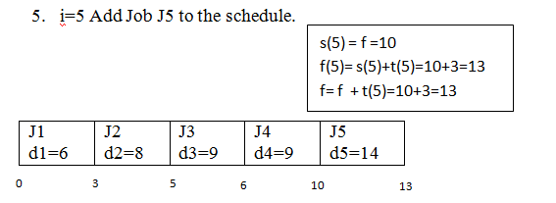
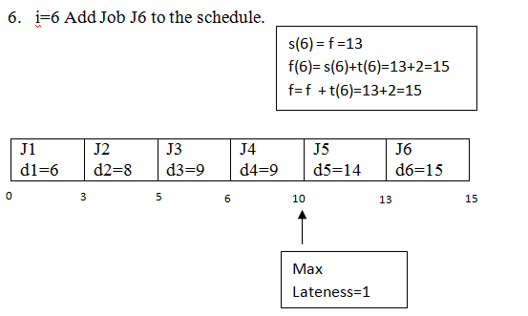
Scheduling to minimize lateness- Example

Slide 52
Scheduling to minimize lateness- Running time
O(n logn)
O(n)

Slide 53
Interval Scheduling
Tug of war
Quiz
Dance
Personality development
Face painting
up
Algos
CO
TOC
Algo Lab

Slide 54
Interval scheduling
Events | Time (ti) | Deadline (di)
MP | 3 | 3
Algos | 3 | 6
CO | 2 | 8
TOC | 3 | 12
Algo Lab | 4 | 20
Personality development | 5 | 5
Face painting | 4 | 10
Dance | 3 | 16
Tug of war | 3 | 6
Quiz | 2 | 14

Slide 55
Scheduling to minimize lateness- Proof of correctness
There is an optimal schedule with no idle time and no inversions
(a) There is an optimal schedule with no idle time
We will show that if there is another schedule O (think optimal schedule)
then we can gradually change O so that
at each step the maximum lateness in O never gets worse
it eventually becomes the same cost as A
O → A (Exchange argument)

Slide 56
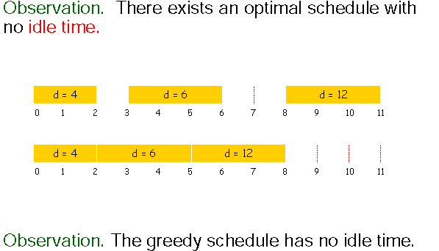
Scheduling to minimize lateness- Proof of correctness
There is an optimal schedule with no idle time and no inversions
(a) There is an optimal schedule with no idle time

Slide 57


Scheduling to minimize lateness- Proof of correctness
There is an optimal schedule with no idle time and no inversions
(a) There is an optimal schedule with no idle time.
(b) There is an optimal schedule with no inversions.
Identical
Non- Identical

Slide 58
Minimizing Lateness: Inversions
Def. Given a schedule S, an inversion is a pair of jobs i and j such that: d(j) < d(i) but i scheduled before j.
inversion
f_{j}
i
j
2
d(j)<5
d(i)>3
3
5

Slide 59
Minimizing Lateness: Inversions
Def. Given a schedule S, an inversion is a pair of jobs 1 and 2 such that: d(2) < d(1) but 1 scheduled before 2.
inversion
f_{j}
before swap
1
2
2
i
j
3
5
d(2)<5
d(1)>3
after swap
2
1
2
j
4
i
f‘_{i}
5
L1’= 5- 4 (say d1)=1
=5-4=1
L2=5- 4(say d2)=1

Slide 60
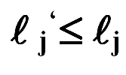
Minimizing Lateness: Inversions
Def. Given a schedule S, an inversion is a pair of jobs i and j such that: d(j) < d(i) but i scheduled before j.
Claim. Swapping two consecutive, inverted jobs reduces the number of inversions by one and does not increase the max lateness.
Pf. Let  be the lateness before the swap, and let  ' be it afterwards.
● '_{k} = _{k} for all
k ≠ i, j.
If job i is late:
inversion
f_{j}
before swap
i
j
after swap
j
i
f‘_{i}

Slide 61
Part 2 Greedy algorithms on Graphs

Slide 62
DIJKSTRA’S ALGORITHM
PROBLEM
Often when we traverse from one point to another or from one place to another place,we want to know the shortest path.
Given a graph G=(V,E) which models the shortest path problems ,we may want to determine-
Given node u,v what is the shortest u-v path
Given a start node ‘s’ ,what is the shortest path from s to each other node

Slide 63
SET UP OR INPUT INSTANCE SET UP
The edges in the graph has a length l_{e} >=0
l_{e} ->indicate time it takes to traverse e
->usually associated as cost to travel
Take u=1,v=2, l_{e} =1
u=1,v=5
1 6 l_{e} ={1,4}+{4,5}=3+4=7
={1,2}+{2,5}=1+5=6
2 5 ={1,2}+{2,4}+{4,5}
3 4 7 =1+2+4=7
2
1
33
4
5

Slide 64




ALGORITHM
//Algorithm:Dijkstra’s Algorithm
1
2

Slide 65
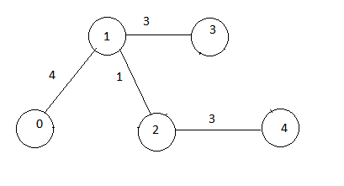
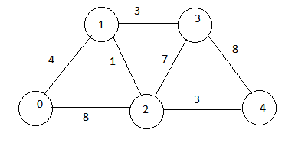

Example
d

Slide 66
Dijkstra’s algorithm example
Source =0
s | Distance[] d[] | Min(d[u]+le)
{0}
0
1
2
3
4
0 | ₉₉₉ | 999 | 999 | 999

Slide 67
Dijkstra’s algorithm example
Source =0
s | Distance[] d[] | Min(d[u]+le)
{0,1} |  | u=0 or u=0 v=1 v=2 min(0+4)=4
0
1
2
3
4
0 | ₄

Slide 68
Dijkstra’s algorithm example
Source =0
s | Distance[] d[] | Min(d[u]+le)
{0,1,2} |  | u=0 or u=1 v=2 v=2 min(0+8)=8 and (4+1)=5
0
1
2
3
4
0 | 4 | 5

Slide 69
Dijkstra’s algorithm example
Source =0
s | Distance[] d[] | Min(d[u]+le)
{0,1,2,3} |  | u=1 or u=2 v=3 v=3 min(4+3)=7 and (4+7)=11
0
1
2
3
4
0 | 4 | 5 | 7

Slide 70
Dijkstra’s algorithm example
Source =0
s | Distance[] d[] | Min(d[u]+le)
{0,1,2,4} |  | u=3 or u=2 v=4 v=4 min(3+8)=11 min(5+3)=8
0
1
2
3
4
0 | 4 | 5 | 7 | 8

Slide 71
Depth of intervals
the depth of a set of intervals to be the maximum number that pass over any single point on the time-line.

Slide 72
Analysis
In any instance of Interval Partitioning, the number of resources needed is at least the depth of the set of intervals.
Proof. Suppose a set of intervals has depth d, and let I1, . . . , Id all pass over a common point on the time-line.
Then each of these intervals must be scheduled
on a different resource,
so the whole instance needs at least d resources.

